Slide 1
Prototyping
Introduction
What is prototyping?
Why is prototyping important in a design workﬂow?
Lo-Fi and Hi-Fi prototypes
Guidelines for Prototyping
Example of Using Prototype
Advantages and Disadvantages of Prototyping
What is prototyping in Figma?
Prototyping in Figma is a way for designers to create interactive previews of their
designs (how users will interact with the design). These previews, or prototypes,
act like early versions of a product, letting teams try out design ideas before fully
developing them. In Figma, you can make prototypes that look and feel close to
the ﬁnished product and share them with others to get feedback. This feedback
helps make sure the design works well for the people who will use it, saving time
and money by catching any issues early on.
Why is prototyping important in a design workﬂow?
•
•
•
•
•
It lets users see and interact with a product's early model, so they
understand how it will work.
It provides stakeholders with a visual and functional representation of the
product, helping them see potential beneﬁts, risks, and costs.
It helps identify and minimize unnecessary elements before product
release by getting early feedback from your target audience.
It is much cheaper to share and iterate ideas at this stage than after
development
It enables the exploration of diﬀerent design approaches quickly, making it
easier to compare and choose the best solution.
Low-ﬁdelity vs High-ﬁdelity prototyping
At the start of making something new, designers often use basic models called
"Lo-Fi" prototypes. These are simple and not too detailed, kind of like a draft.
They might show how to go from one screen to another, but they won't have all
the fancy parts yet. Even though they're simple, these early models are really
useful. They help designers and the people they're working for to see if an idea is
going to work. This way, they can ﬁgure out if an idea is good or not without
spending a lot of time and eﬀort on it.
Here's what these simple versions can look like:
Telling a story with pictures to show how your idea works.
Drawing your ideas on paper (even though some smart folks say drawing isn't
quite the same as making a model).
Sorting ideas like playing cards to organize them.
Pretending your idea works to see how people react to it.
The advantages of the Lo -Fi prototype:
They're fast and don't cost much.

Slide 2
You can change them easily and try out diﬀerent things quickly.
It's okay if you mess up; you can just start over.
They help you get a big picture of your idea without getting stuck on little details.
Anyone can make them, no matter how much experience they have.
They help you get creative and think about the design.
The disadvantages of the Lo -Fi prototype:
They don't feel like the real thing, so they might not give you the best test
results.
If your real product needs to be just right for certain people, like those with
disabilities, these rough versions might not help much.
They usually mean the person trying out your idea doesn't get the full
experience like they're just pretending or telling you what they would do instead
of actually doing it.
When you're halfway done making your idea real, you might make a "Hi-Fi"
prototype. This is a fancy version of your model that looks and works a lot like
what you want to end up with. At this point, you might check just one important
part of your idea to make sure it's working great, while other parts are still being
worked on. As you get closer to ﬁnishing, you'll make even better versions that
look good, work smoothly, and make sense from start to ﬁnish.
High-ﬁdelity prototypes require more time to create and revise, with designs
that:
Solve UX and UI problems with reﬁned functionality and interactivity
Include speciﬁc, fully functional features for user testing
Cover more details, including conditional logic, micro-interactions, polished
animations, and even hardware functionality (like phone cameras or sensors)
The advantages of the Ho-FI prototype:
•
They're really eye-catching, and the people who care about the project can
see exactly how their ideas will turn out. This helps them decide if they
like it and if it has everything they need.
•
When you let people try these detailed models, you get really good
feedback that you can trust. Since these models are so close to the ﬁnal
thing, you'll know how people will really feel about your product.
The disadvantages of the Ho-Fi prototype:
•
•
•
•
They generally take much longer to produce than low-ﬁ prototypes.
Designers might not want to change things after they've spent so much
time making the product and work just right.
Software prototypes may give test users a false impression of how good
the ﬁnished article may be.
•
Making changes to prototypes can slow everything down because it takes
longer time than making quick changes to Lo-Fi prototypes.
Guidelines for Prototyping
It is important to remember that prototypes are supposed to be quick and easy
tests of design solutions. Here are a few guidelines that will help you in the
Prototyping stage:
• Just start building

Slide 3
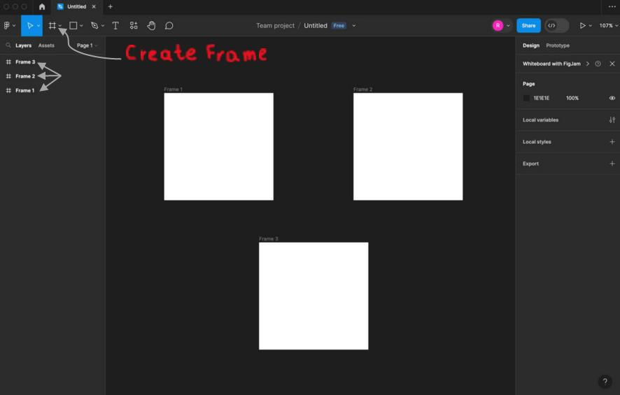
When you’re unsure about your idea, the best thing to do is to start making a
model of it. This hands-on approach will help you see your idea more clearly and
might give you new ways to make it better.
• Don’t spend too much time
Making a model should be quick. If you spend too much time on it, you might
start liking your idea too much. This can make it hard to see if it's truly a good
idea or not.
• Keep your main goal in mind
Every prototype should focus on one main thing you want to check. Make sure
you don't forget this main point but also be open to learning other things from
your model.
• Think about the people who will use it
Test the prototype against expected the people who will use your ﬁnal product.
See where there are diﬀerences between what you thought would happen and
what actually happens, and use this to make your idea better.
Small Example of Using Prototype in Figma
For this example, we will use three Frames, so let’s create them:
So, as you see we created three Frames (pages), let’s give them background
colors:
For that, click on one of your frames and go to Design settings.

Slide 4
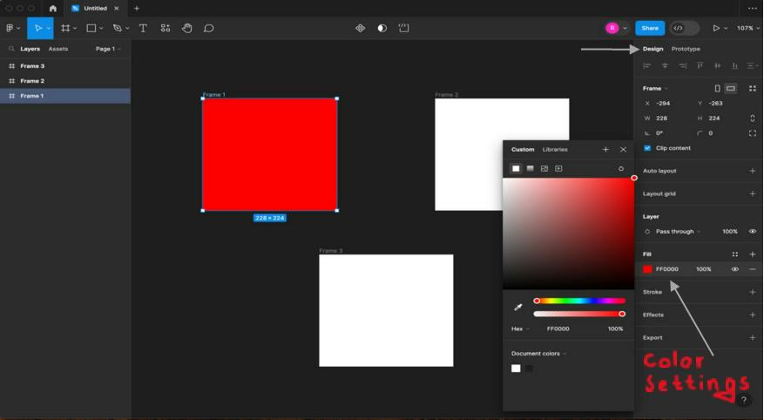
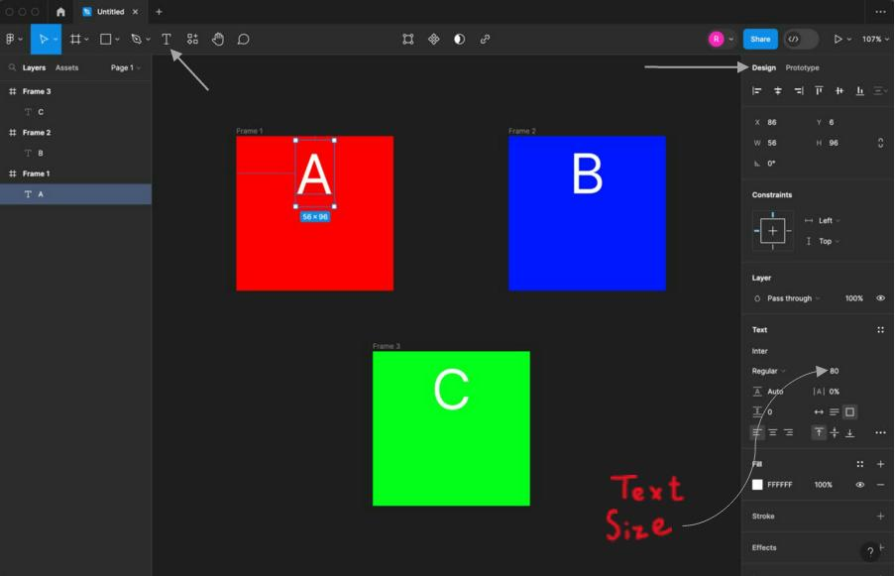
Now let’s put the names for the pages and put some colors to our page(A, B, C):
For that click on the Text and write the names for our pages.
Great! Let’s make interactions of pages:

Slide 5
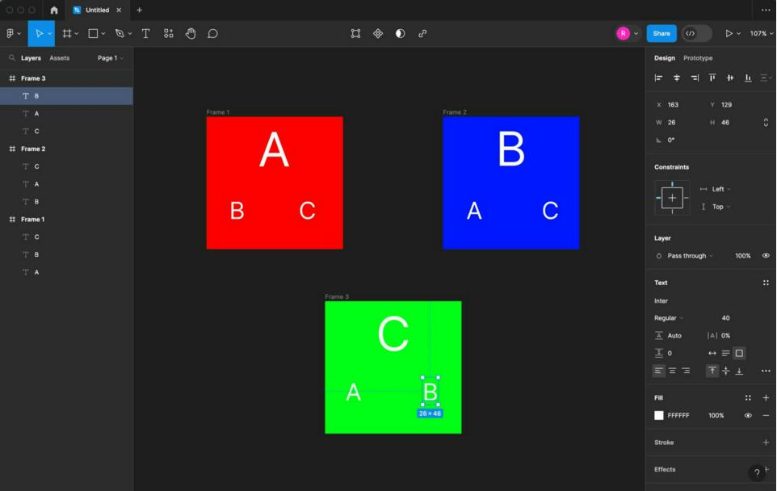
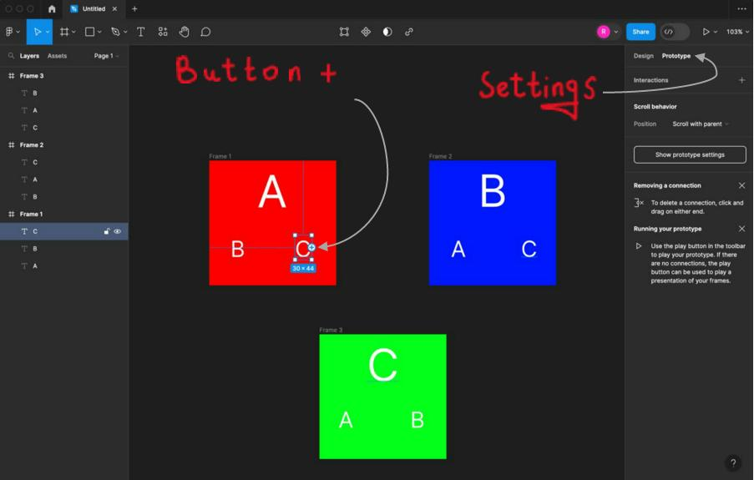
So, now we can make functional interactions between pages:
For that, we will go to prototype settings, and by clicking on C (or B) we can see
a small button +, by clicking on that button we can move the label to another
Frame(page), so it will move as to another page, in our picture example to C
page.

Slide 6
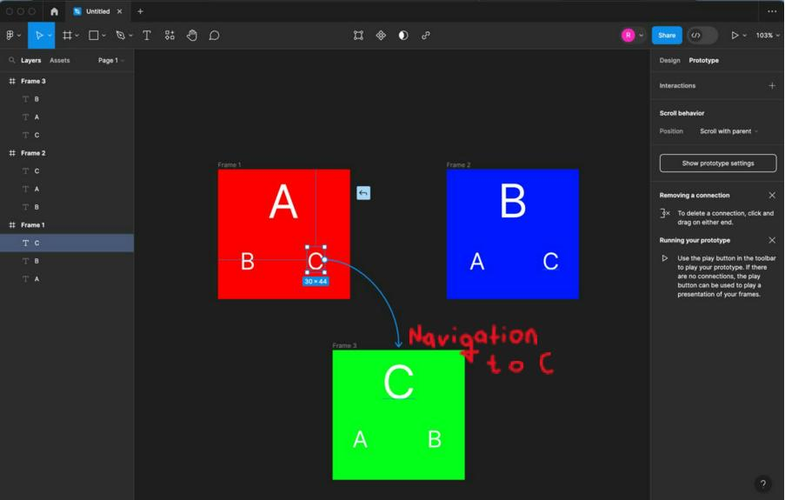
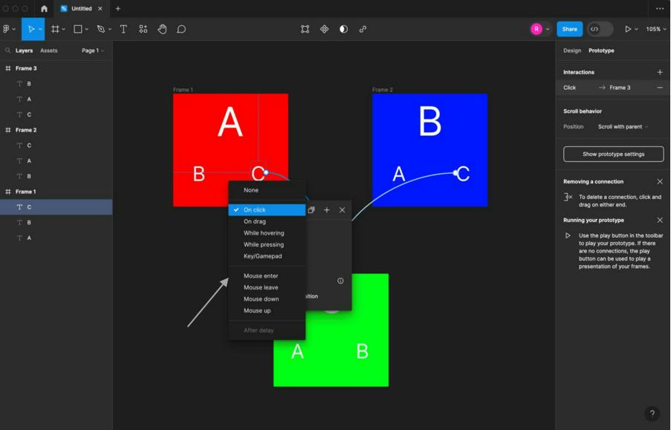
Okay, we connected all pages between them, let’s look at actions for going to
another page, click on the label, and choose the action that you want.
We can choose an animation for moving to another Frame(page), by clicking on
the label:

Slide 7
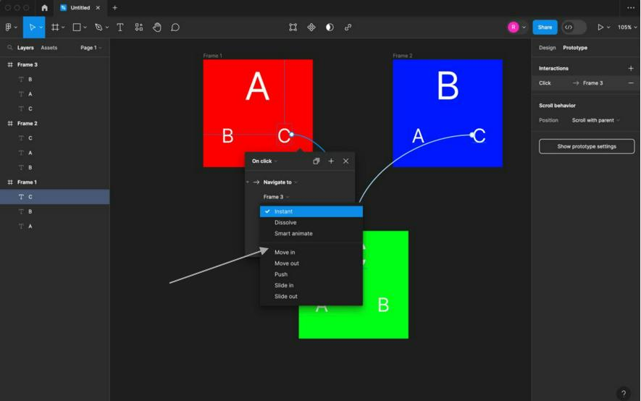
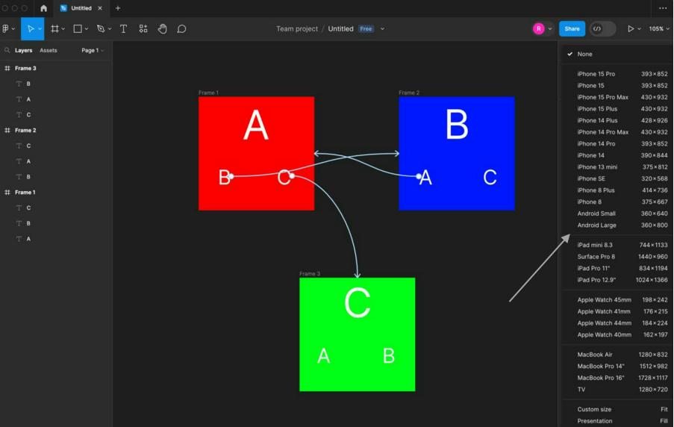
In Prototype settings, we can choose, for which Device we will make our
prototyping, our device now in our example is Presentation:
In the prototype setting we can change our prototype's background color:

Slide 8
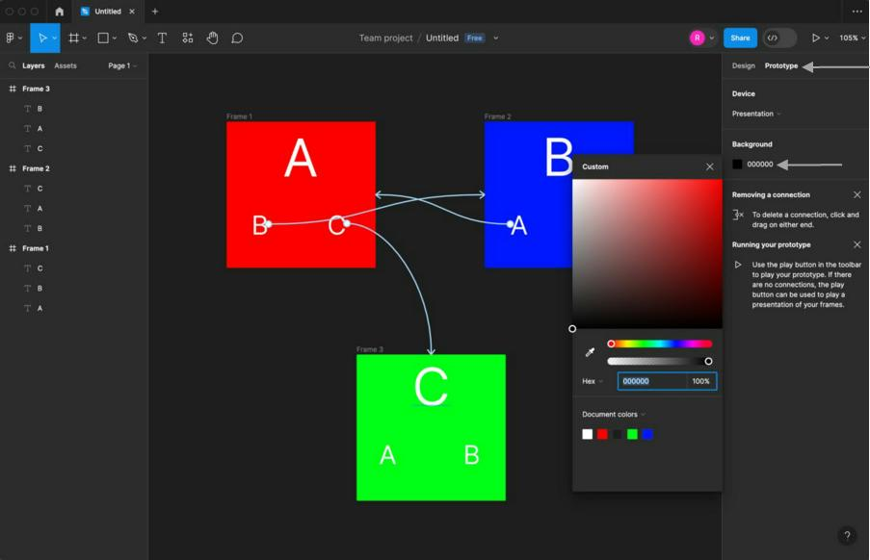
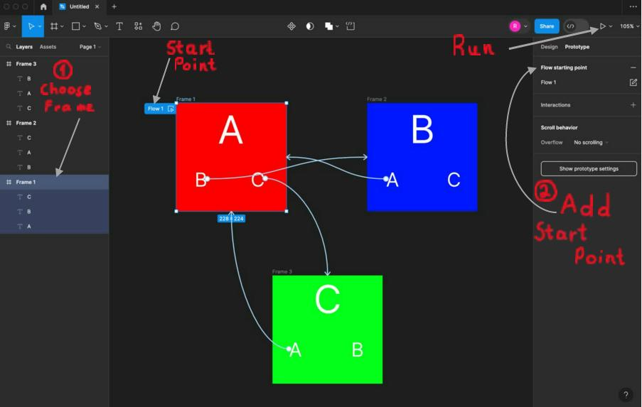
So, now we can run our prototype:
But before running let’s choose from which frame our prototype should start.
•
Firstly choose Frame, and click on it, after that, in the Prototype setting
click on Flow Starting Point, as you we have Flow 1 in our Frame 1, we can
move that Flow 1 to another frame, of course, if you want to run your
prototype and start with another Frame.
•
For running our Prototype, we should click to Play button.
Congratulations, we ran our prototype successfully!

Slide 9
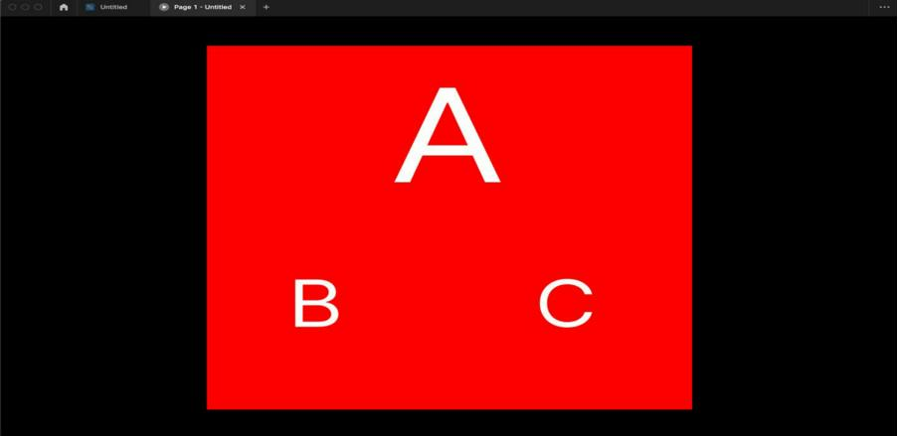
After Running our Prototype, we can move B or C pages, just by clicking. This is a
small example that show us how Prototyping is working in Figma.
So let’s talk about Advantages and Disadvantages of Prototyping:
Advantages:
▪ This model is ﬂexible in design.
▪ It is easy to detect errors.
▪ It can actively involve users in the development phase.
▪ It helps developers and users both understand the system better.
▪ We can ﬁnd missing functionality easily.
▪ There is scope of reﬁnement, it means new requirements can be
easily accommodated.
▪ It can be reused by the developer for more complicated projects in
the future.
▪ It ensures a greater level of customer satisfaction and comfort.
▪ Integration requirements are very well understood and deployment
channels are decided at a very early stage.
Disadvantages:
▪ This model is costly.
▪ It has poor documentation because of continuously changing
customer requirements.
▪ There may be too much variation in requirements.
▪ Customers sometimes demand the actual product to be delivered
soon after seeing an early prototype.
▪ There may be sub-optimal solutions because of developers in a
hurry to build prototypes.
▪ Customers may not be satisﬁed or interested in the product after

Slide 10
seeing the initial prototype.
▪ There may be incomplete or inadequate problem analysis.
▪ There may increase the complexity of the system.

